Slide 1
CARA – The Shopping Site
Group No:22
Dil Sharma (2410990134)
Sahibjeet Singh (2410991872)
Dewan (2410990125)
Submitted To
Dr . Ravneet kaur
Department of Computer Science and Engineering
Chitkara University Institute of Engineering & Technology, Punjab

Slide 2
Table of Contents
Introduction
Problem statement
Technical Details
Key features
Project highlights
Conclusion
Flow chart

Slide 3
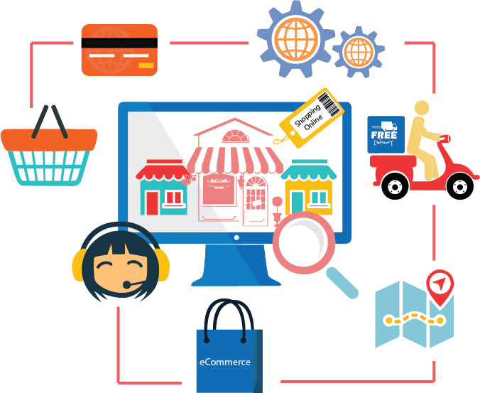
Introduction
In today's digital age, online shopping has become an integral part of our lives. With the rise of e-commerce, consumers are constantly seeking convenient, secure, and personalized shopping experiences. Introducing "CARA", your one-stop destination for all your shopping needs. Our website aims to provide an unparalleled shopping experience, offering an extensive range of products, competitive prices, and exceptional customer service. In this presentation, we will take you through the features, benefits, and unique selling points of "CARA". We will explore how our platform addresses the evolving needs of online shoppers, and what sets us apart from the competition.

Slide 4

Problem Statement
"CARA" solves various problems for consumers, businesses, and the overall shopping experience:
Time-saving
Price comparison.
Global reach.
Secure transactions.
Improved customer engagement: Personalized experiences.
Product variety: Browse multiple brands and categories.
Environmental benefits: Reduce carbon footprint.

Slide 5

Technical Details
HTML (index.html):
Set up the basic structure of the page.
Include a header with the title.
Create a container for displaying search results.
CSS (styles.css):
Style the header and other elements as needed.
Define the layout for the results container.
Style individual product items.

Slide 6
Key Features
User-friendly interface
Advanced search and filtering.
High-quality product images.
Clear product information.
Secure payment gateways.
Personalized recommendations.
Efficient checkout process.

Slide 7
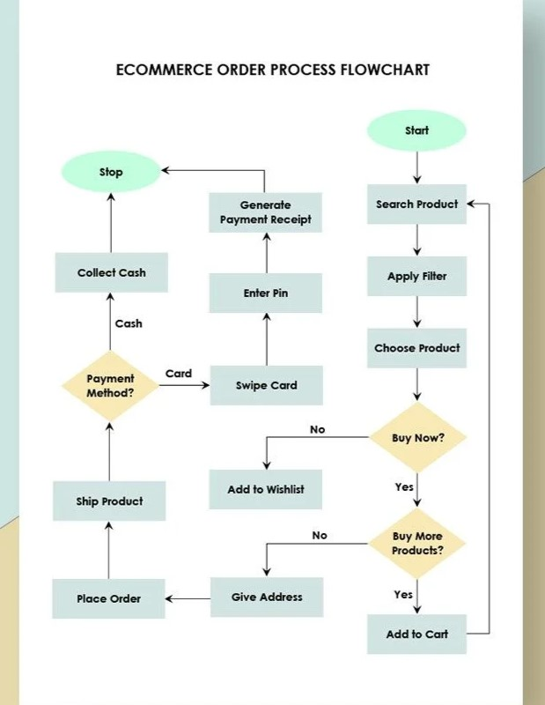
Flow Chart

Slide 8
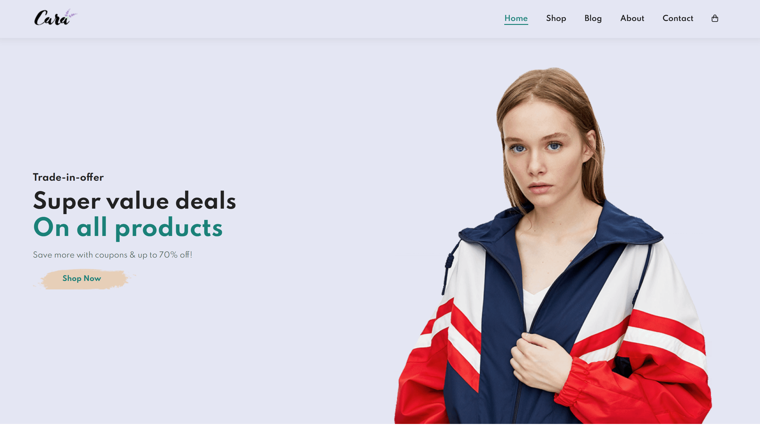
Project highlights

Slide 9
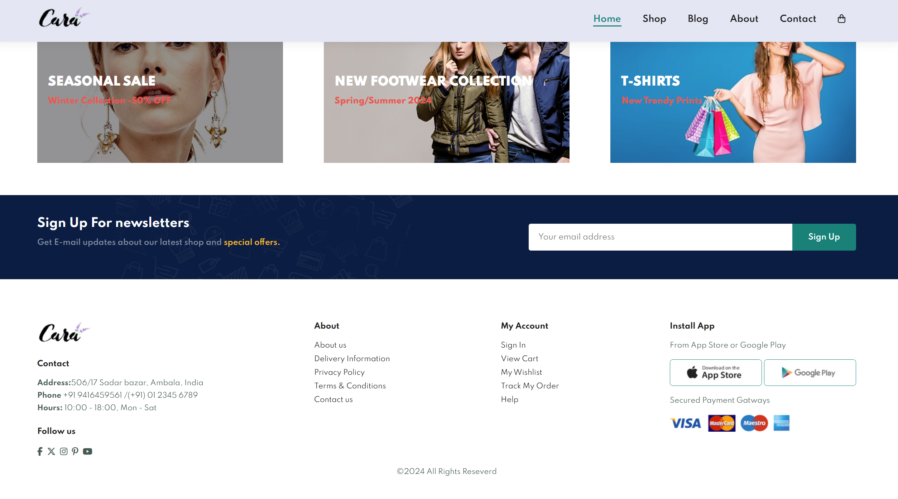
Project highlights

Slide 10

Conclusion
In conclusion, "CARA" offers a cutting-edge e-commerce solution that:
- Enhances customer experience through intuitive design and personalized features
- Increases conversions with streamlined checkout and secure payment options
- Supports business growth through scalable architecture and data-driven insights
- Fosters trust with robust security measures and compliance standards

Slide 11

Reference
https://www.geeksforgeeks.org/types-of-e-commerce/
https://www.researchgate.net/figure/Flow-chart-diagram-Online-e-commerce-shopping-web-app_fig1_347169962
https://developer.mozilla.org/en-US/docs/Web
https://www.w3schools.com/whatis/
MDN Web Docs (mozilla.org)

Slide 12


